Slide 1


Power System Grounding Shipboard Power System Fundamentals Revision of 4 February 2026
Dr. Norbert Doerry
http://doerry.org/norbert/MarineElectricalPowerSystems/index.htm
© 2026 by Norbert Doerry This work is licensed via: CC BY 4.0 (https://creativecommons.org/)

Slide 2
Essential Questions
What are the characteristics of ungrounded, high resistance grounded and solidly grounded power systems? | Understand
What are common mode voltages and currents; how do ground faults impact common mode voltages and currents; what are the implications of common mode currents flowing in the ship’s hull? | Understand
What are separately derived systems, how are they implemented, and what are the implications of not operating two power systems as separately derived systems? | Understand
How are ground faults detected and localized for the different types of grounding systems? | Understand
When should each type of grounding system be employed onboard ship? | Understand

Slide 3
Types of grounding systems onboard ship
Power system grounding
Protect insulation systems on shipboard power cabling, transformers, motors, generators, and other components.
Subject of this presentation.
Equipment grounding (Protective earthing)
Protect personnel by bonding all exposed conductors together so they are the same voltage.
Common mode grounding
Provide a designed path for higher frequency common mode currents instead of through parasitic impedances. Typically, implemented via Electromagnetic Interference (EMI) filters.
Cathodic protection
Inhibit galvanic corrosion of the hull and other ship components.
Lightning protection
Provide a designed path for lightning currents into the water.

Slide 4
Grounding methods for shipboard power systems
Ungrounded
Traditional method used on ac systems with nominal system voltages at or below 1000 volts.
Recommended option for systems with a nominal system voltage at or below 1000 volts with mission critical equipment.
Enables operation with a single line-to-ground fault.
Susceptible to damaging transients from intermittent ground faults.
High Resistance Grounded
Recommended for use on ac and dc systems with nominal system voltages above 1000 volts.
Recommended option for systems with a nominal system voltage at or below 1000 volts with mission critical equipment.
Enables operation with a single line-to-ground fault.
Much less susceptible to damaging transients from intermittent ground faults as compared to ungrounded systems.
Solidly grounded
Recommended for use on ac and dc systems with nominal system voltages below 1000 volts and supplying only non-vital loads.
Improves compatibility with equipment designed for terrestrial power systems.
A line-to-ground fault is cleared by the fault protection system (circuit breakers).

Slide 5
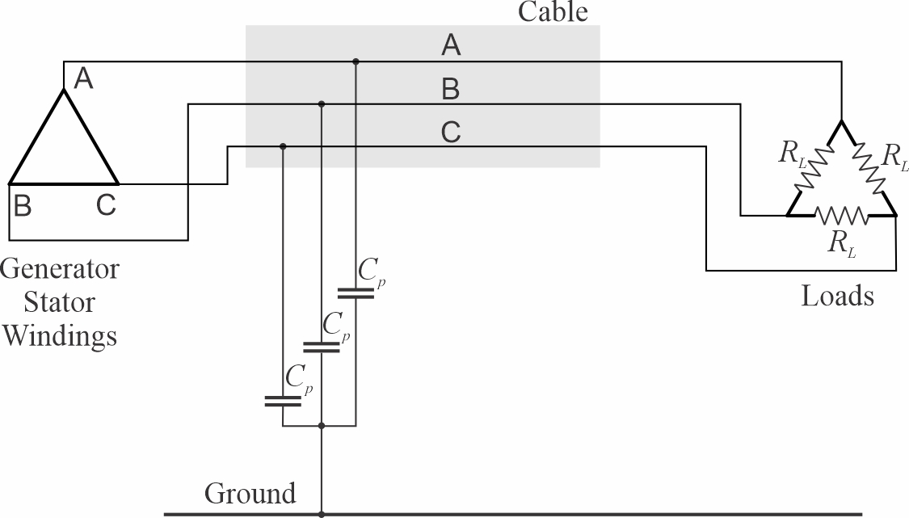
Ungrounded power systems
No intentional connection between power system conductors and ground.
Parasitic capacitances effectively make an ungrounded system capacitively grounded.
Under normal balanced conditions, no current flows through the hull from the parasitic capacitances.
Continued operation with a single line-to-ground fault possible.
Line-to-ground insulation must be rated for line-to-line nominal voltage.
Susceptible to large transient voltages during intermittent ground faults and other transient events.

Slide 6
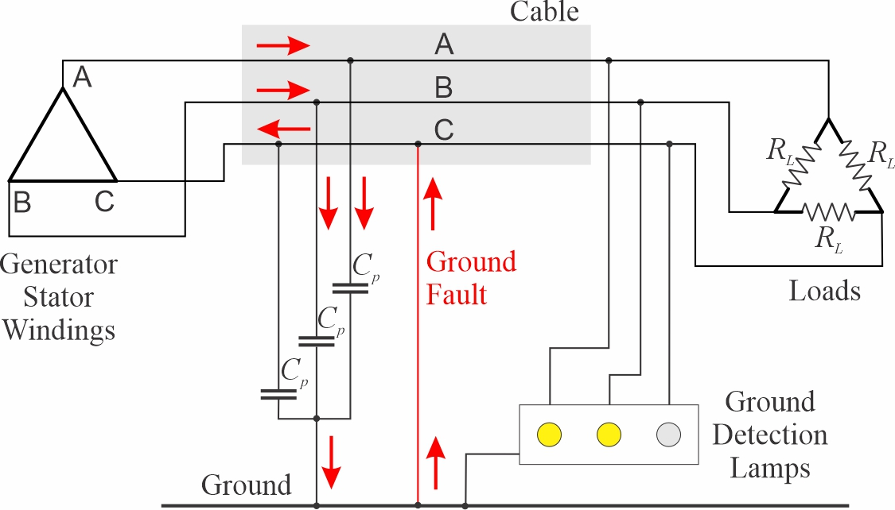
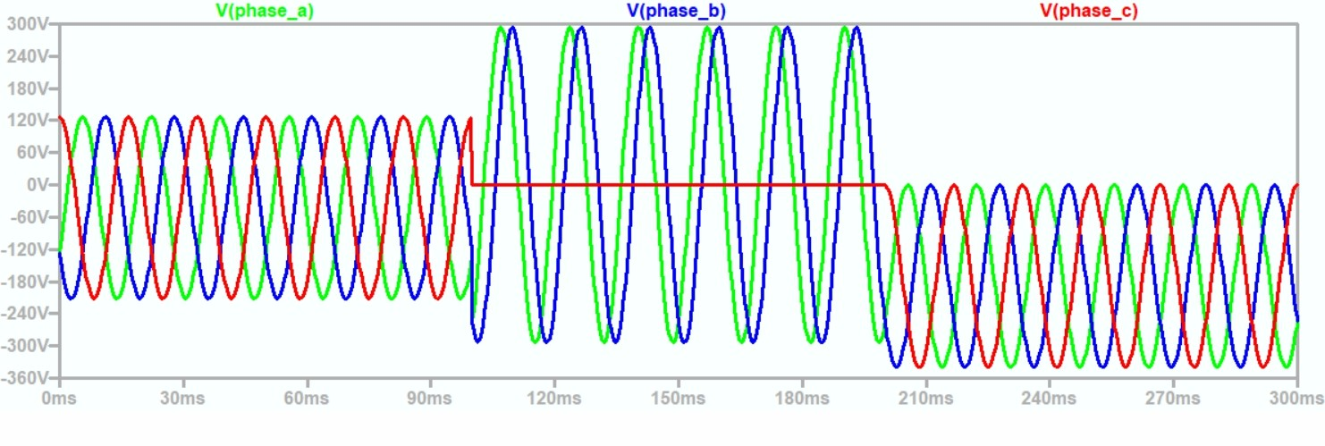

Ungrounded system Ground fault detection and localization
During a ground fault …
Current flows through the parasitic capacitances of the unfaulted phases. (Can have magnitude on the order of 10 amps)
Through the hull of the ship.
Through the ground fault.
Back to the source on the faulted phase.
During a ground fault, the unfaulted phase line-to-ground voltage is equal to line-to-line voltages.
After the fault clears, the neutral voltage of the power system may have a dc offset.
Ground detection lamps may be used to detect ground fault.
Light on grounded phase will go dark, other phases will be bright.
Insulation monitoring systems may also detect ground faults.
Localization of ground faults may be challenging.
Typically, circuits are systematically isolated (turning the circuit breaker off) when the ground fault disappears, the isolated circuit has the ground fault. (Operators may not allow a circuit to be turned off)
Line-to-line voltage magnitude
DC offset on neutral voltage

Slide 7
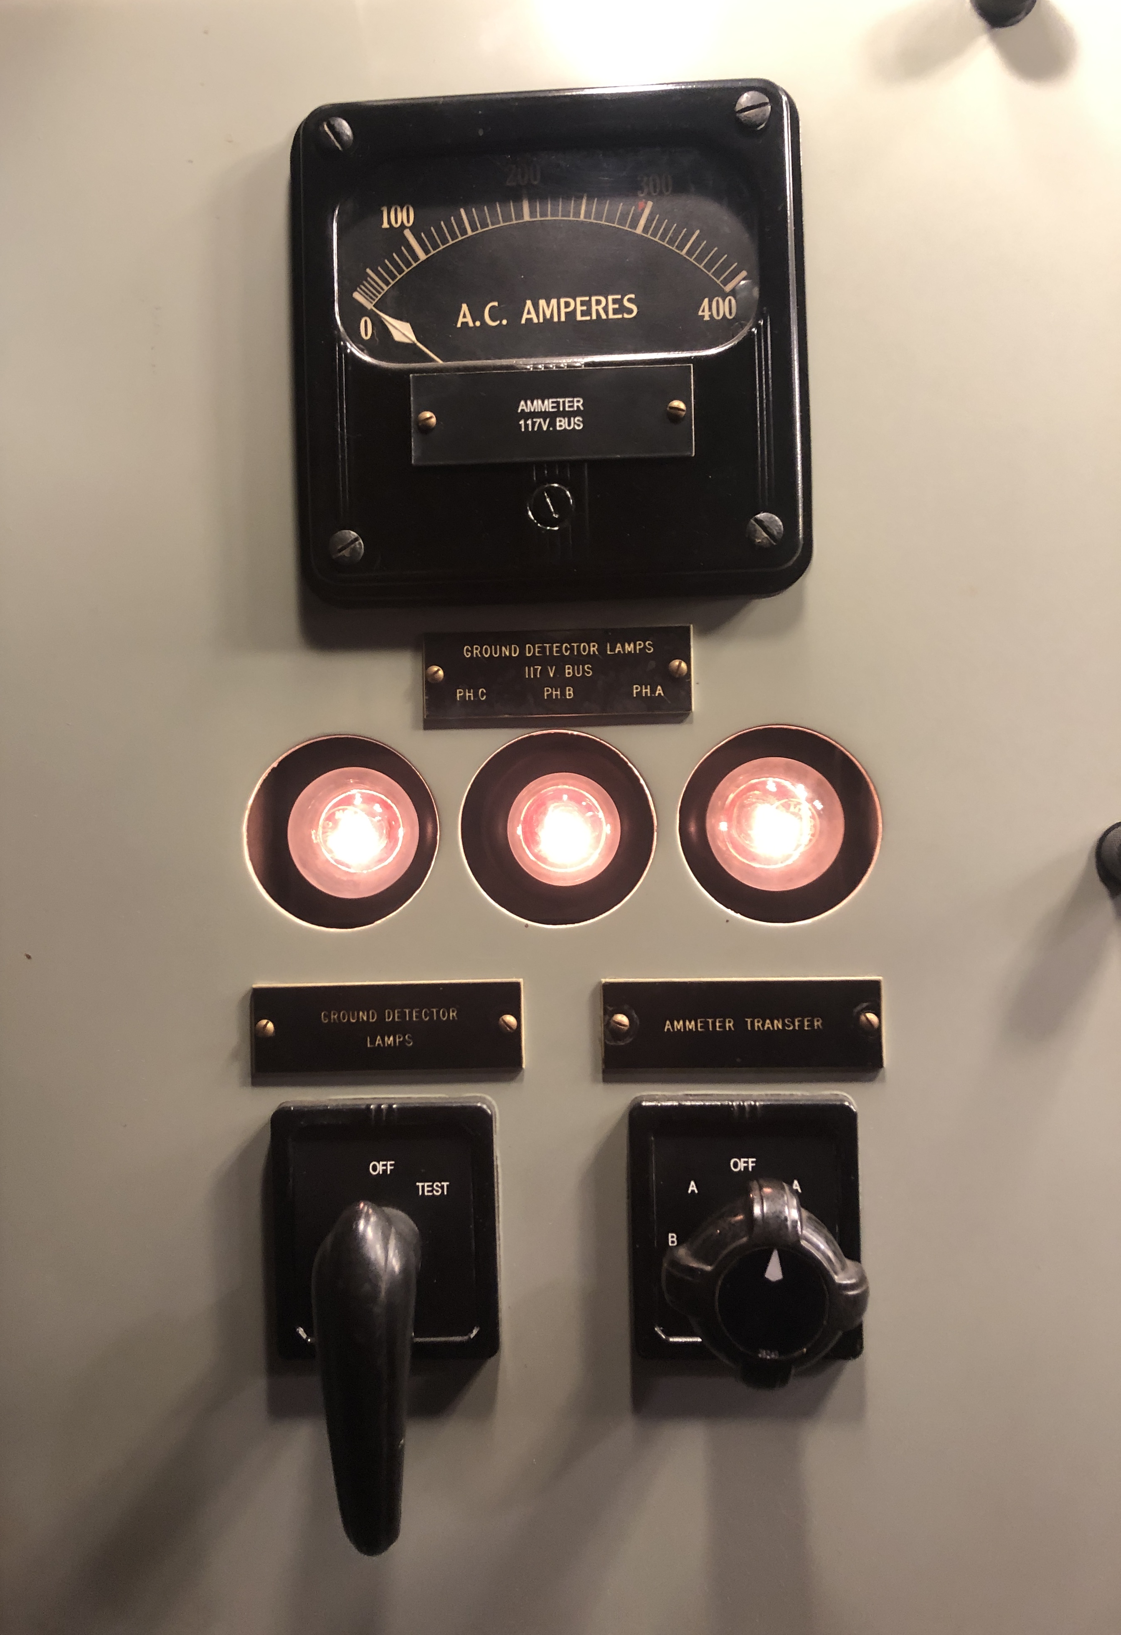
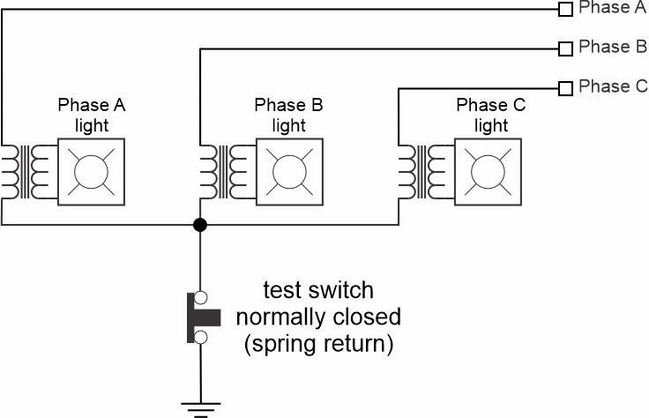
Ground Detection Lamps
Works on Ungrounded and High Resistance Grounded systems.
Normally, all three bulbs are dim.
During a ground fault one bulb will not be lit and the other two will be bright.
Unlit bulb indicates faulted phase.
Test button checks to see if the unlit bulb is burned out.

Slide 8
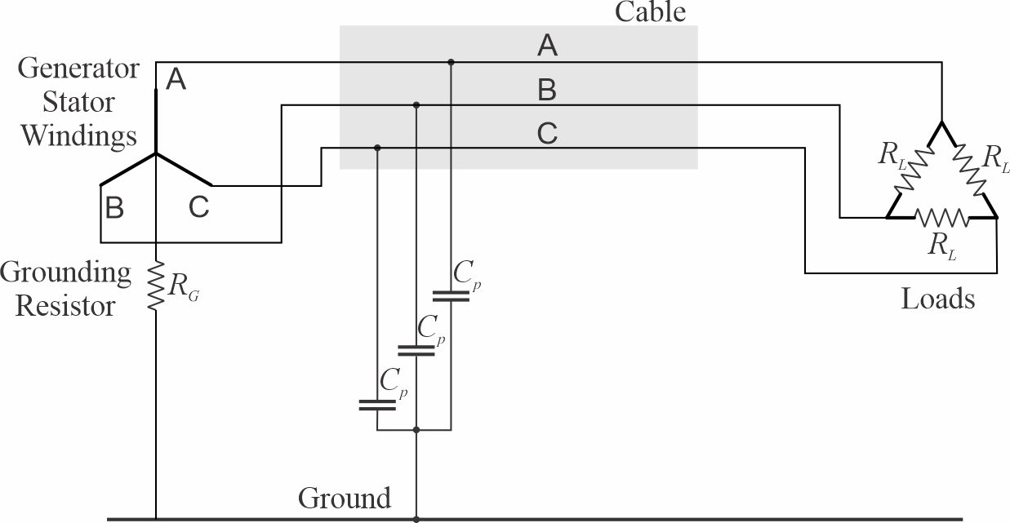
High resistance grounded power system
Neutral of the power system connected by Grounding Resistor to ground.
Resistor resistance should roughly equal the magnitude of impedance of the parallel combination of the parasitic capacitances.
Resistor should have power rating greater than the line to neutral voltage squared divided by the resistance.
A grounding transformer is required if the source is a delta winding.
Under unfaulted conditions, no current flows through the hull of the ship.
Continued operation with a single line-to-ground fault possible.
Ground fault currents not high enough to trip circuit breakers.
Line-to-ground insulation must be rated for line-to-line nominal voltage.
Much reduced susceptibility to large transient voltages during intermittent ground faults and other transient events.

Slide 9
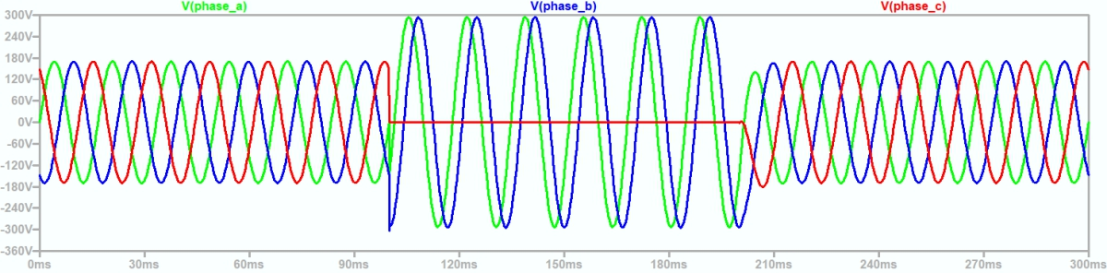

High resistance grounded system Ground fault detection and localization
During a ground fault …
Current flows through the parasitic capacitances as in ungrounded case.
Current also flows through the faulted phase, through the ground fault, and back through the grounding resistor.
Total fault current is about 40% higher than for ungrounded system.
During a ground fault, the unfaulted phase line-to-ground voltage is equal to line-to-line voltages.
After the fault clears, the power system neutral voltage should not have a dc offset.
Ground detection lamps may be used to detect a ground fault.
A voltage on the grounding resistor also indicates a ground fault.
Insulation monitoring systems are not compatible.
Localization of ground faults less challenging.
May use same method as for ungrounded system.
May also use a clamp on current meter around all three phases to detect the fault current from the grounding resistor.
On some systems, a second grounding resistor is periodically (roughly 1 Hz) placed in parallel with primary grounding resistor to make it easier to detect the grounded circuit with the clamp on meter.
Other ground localization methods may employ a higher frequency signal that may be detected by a wireless receiver; obviating need for clamp on current meter.
No DC offset on
Neutral voltage

Slide 10
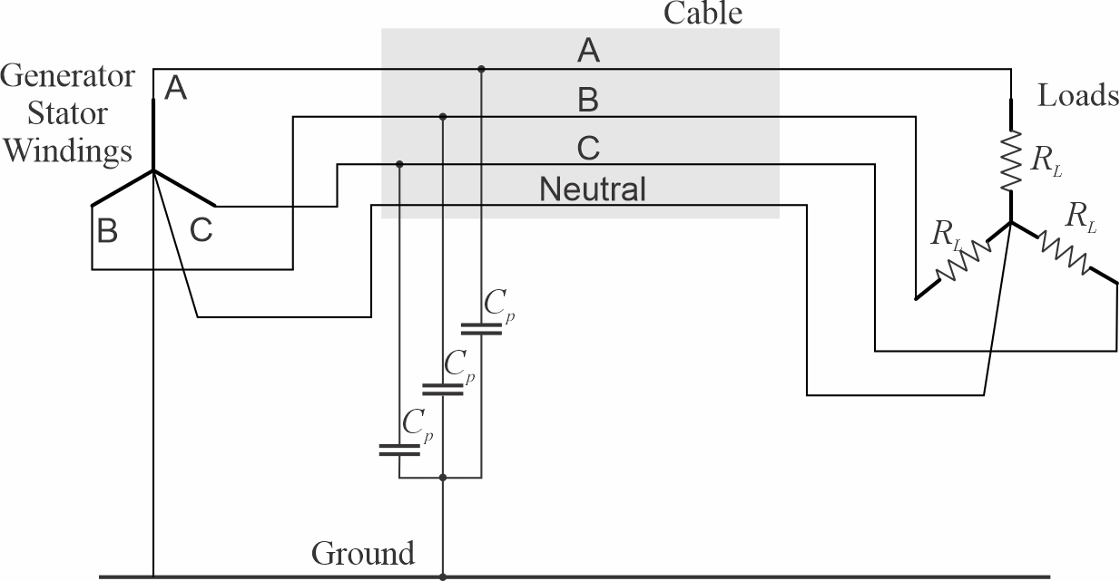
Solidly grounded power system
The neutral connection of the wye connected source is solidly connected to ground.
The neutral connection of wye connected loads may also be solidly connected to the neutral connection of the wye connected source.
Enables loads with two different voltage ratings (120 / 208 V for example).
During a ground fault, large fault currents flow.
Circuit breakers trip to isolate the ground fault.
Loads on faulted circuits automatically lose power; even when it is not desirable.
Generally limited to circuits where the loads are all non-vital.
Line-to-ground Insulation need only be rated for line-to-neutral voltages.
Much reduced susceptibility to large transient voltages during intermittent ground faults and other transient events.

Slide 11
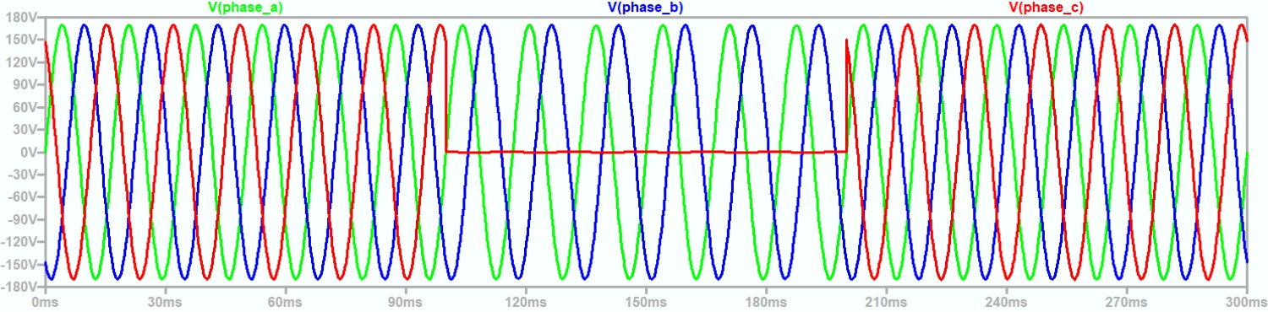
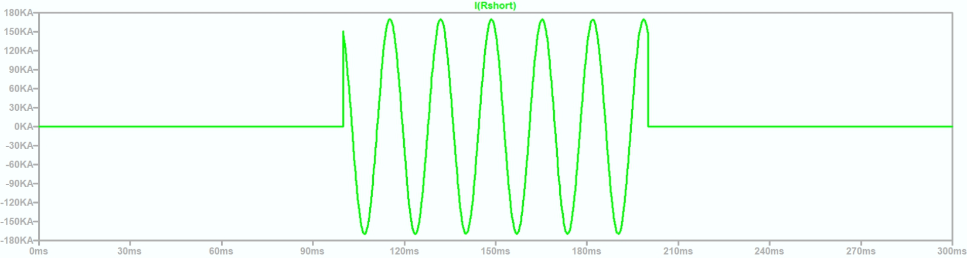
Solidly grounded system Ground fault detection and localization
During a ground fault …
Faulted phase line-to-ground voltage is near zero.
Unfaulted phase line-to-ground voltage nearly unaffected.
Faulted phase current very large … will cause circuit breakers to trip.
Ground detection lamps and insulation monitoring systems are not compatible.
Monitoring current in the ground connection may provide an early warning of an insulation failure on one conductor. (or could indicate a load that is improperly using the ship’s hull as a return path for current.)
Circuit breaker tripping automatically detects, localizes, and isolates a ground fault.
Automatically clearing ground faults may not be desirable for circuits with mission critical loads.
Line to ground voltages
Fault current

Slide 12
Separately Derived Systems
Two separately derived systems do not have a relationship between their neutral voltages.
A ground fault on one system does not result in a ground fault on the other system.
Separately derived systems may still transfer power between them.
Transformers.
Isolated Power Converters.
Examples of systems that are not separately derived:
A dc distribution system fed by a passive rectifier from an ac distribution system.
A converter that does not provide isolation between input and output power systems via an internal transformer or other mechanism.
An ac distribution system fed by an autotransformer from another ac distribution systems.
Possible ramifications of systems not being separately derived.
Need for higher line-to-ground insulation voltage ratings due to ground faults on the higher voltage system causing higher than normal line to ground voltages on the lower voltage system.
Common mode currents flowing under normal operation through both power systems.
Making two distribution systems separately derived reduces system complexity.

Slide 13
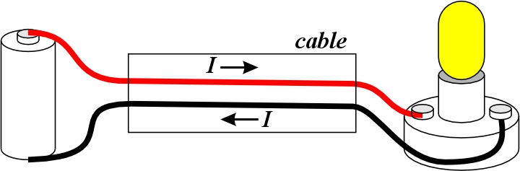
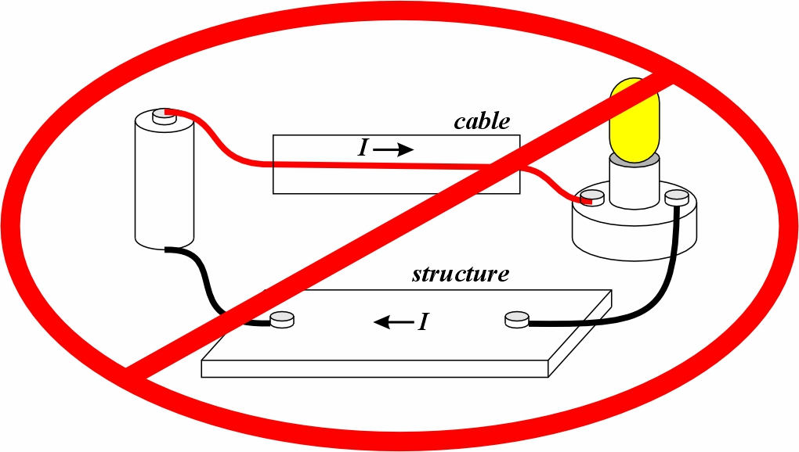
Common mode: Introduction
Shipboard power systems are designed for the “differential mode.”
The sum of the currents in the conductors of a cable are intended to sum to zero.
Unlike many other vehicles, the structure of ships is not intended to carry current under normal conditions.
Prevent corrosion.
Prevent EMI.
Prevent localized heating or fire risk.
A common mode current is the instantaneous sum of the currents in all the conductors of a cable or other grouping of conductors.
The common mode current is a property of a group of conductors.
A common mode voltage is the instantaneous average of the voltages with respect to a reference voltage in all the conductors of a cable or other grouping of conductions.
The common mode voltage is a property of a group of conductors.
May also be called the neutral voltage.
A neutral conductor may or may not be at the neutral voltage.

Slide 14
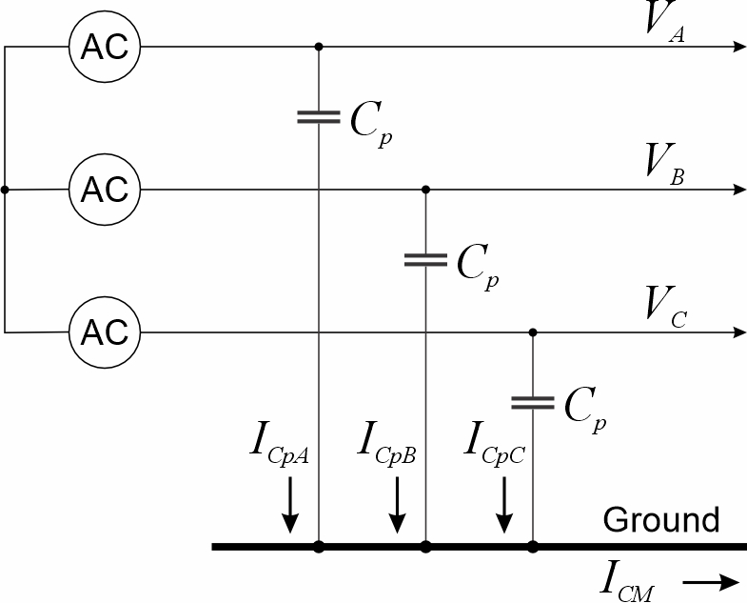
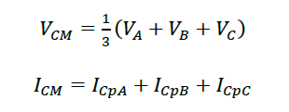

Common Mode
If V_{A}, V_{B} and V_{C} are with respect to ground …

Slide 15
Common mode: Ground faults
A common mode equivalent circuit may be used to easily compute common mode currents (fault currents) and voltages during a ground fault.
Modeling
Ground fault is a voltage source equal to the negative of the line-to-neutral voltage of the faulted phase.
Parasitic capacitance modeled as s capacitor between the neutral with value equal to three times the individual line-to-ground parasitic capacitance.

